Slide 1
Notes:
Redgate has always been passionate it’s users.
We wanted to create an event bringing together Redgate customers, as well as data professionals who had yet to experience Redgate tools.
The SQL community would learn from industry experts, and we would learn from them too.
Each of the events since 2011 had a unique atmosphere but all embraced education, networking and had a great sense of bringing the ‘fun’ element to a day of SQL Server training.

Slide 2
Strategies for solving compliance challenges for the Technology industry

Slide 3


Steve Jones
Evangelist, Redgate Software
Editor, SQLServerCentral
Chris Unwin
Data Privacy and Protection Specialist, Redgate Software
Notes:
steve

Slide 4
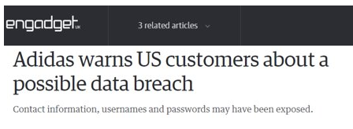
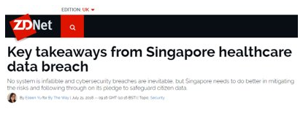
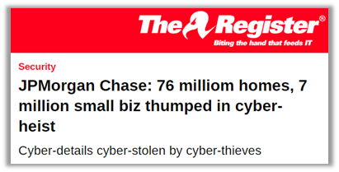
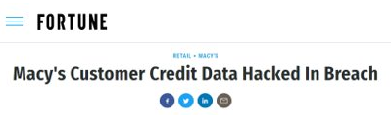
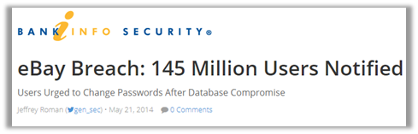
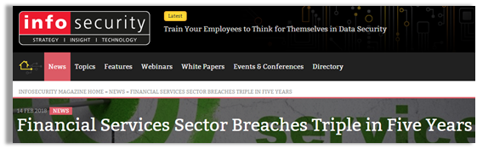
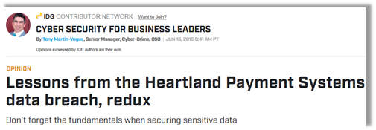
Data Breaches are Headline News
Notes:
Sadly though, Data Breaches continue to plague every industry and put companies assets and reputations at risk.
Most recently, 2 additional data breaches have drawn the public eye:
1) The first of these and potentially the most shocking is the Florida-based marketing and data aggregation firm ‘Exactis’ who suffered a leak, which exposed nearly 2TB of comprehensive data (or in real terms), 340 million US adults and businesses - and this itself was indeed the direct result of inadequate Database protection.
2) The second example of course being the Bank of Montreal and Simplii Financial who were threatened with a $1Million ransom for the combined 90,000 personal details of Canadians that a group of purportedly Russia-based hackers were able to steal.
But where are these breaches coming from? How are they still happening?

Slide 5
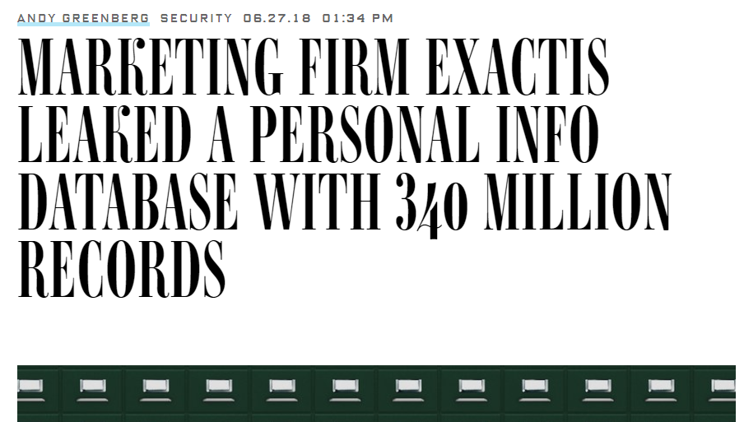
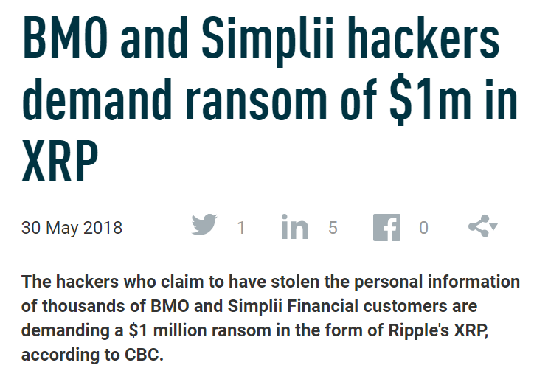
Notes:
https://www.wired.com/story/exactis-database-leak-340-million-records/
https://www.finextra.com/newsarticle/32177/bmo-and-simplii-hackers-demand-ransom-of-1m-in-xrp

Slide 6
Where do these breaches come from?
92%
External Attackers*
for Finance and Insurance industries
56%
Internal Users*
Healthcare
48%
Hacking attacks*
In all cases
12%
Privilege misuse*
*Study from 2018 Data Breach Investigations Report- Verizon
Notes:
So hacking is still top tactic used, privilege misuse and casual events together are close behind – but this isn't always cracking Production wide open, many times this includes making your way in to a network and sniffing around for a disguarded Backup file or trying to get your hands on a pre-production copy which won't share nearly the same level of water-tight security!
Depending on the vertical your company resides in, it varies where the biggest threats are, and the thing to highlight here is that on the whole, breaches CAN come from anywhere, so really it's up to us as curators of the data, or data controllers/processors, to do our due diligence and ensure that data is protected from the start. That access to data is controlled and where possible, data processing is minimized to only what is relevant and necessary – does that sound familiar? Well it should! It's similar across the board for most data protection legislation.

Slide 7
Number 1 asset involved in Breaches:
Databases
Notes:
So hacking is still top tactic used, privilege misuse and casual events together are close behind – but this isn't always cracking Production wide open, many times this includes making your way in to a network and sniffing around for a disguarded Backup file or trying to get your hands on a pre-production copy which won't share nearly the same level of water-tight security!
Depending on the vertical your company resides in, it varies where the biggest threats are, and the thing to highlight here is that on the whole, breaches CAN come from anywhere, so really it's up to us as curators of the data, or data controllers/processors, to do our due diligence and ensure that data is protected from the start. That access to data is controlled and where possible, data processing is minimized to only what is relevant and necessary – does that sound familiar? Well it should! It's similar across the board for most data protection legislation.

Slide 8
Why should we take action?
An Increasing tide of laws & legislation
HIPAA, DPA, SOX, PCI DSS, EU GDPR, CaCPA, S.H.I.E.L.D, NIST (draft, revision 5)…
Ongoing industry specific regulations & requirements
Securities & Exchanges Commission (SEC) Federal Trade Commission, Commodity Futures Trading Commission (CFTC), The Financial Conduct Authority, NHS Digital…
Non-compliance results in fines or prison!
Notes:
HIPAA – up to $50,000 per record, $1.5m per year
FCA/PRA - £56m for RBS Group (2014)
SOX – up to $5m for incorrect certification
EU GDPR & NIS Directive – up to 4% of global revenue or €20m
Prison

Slide 9
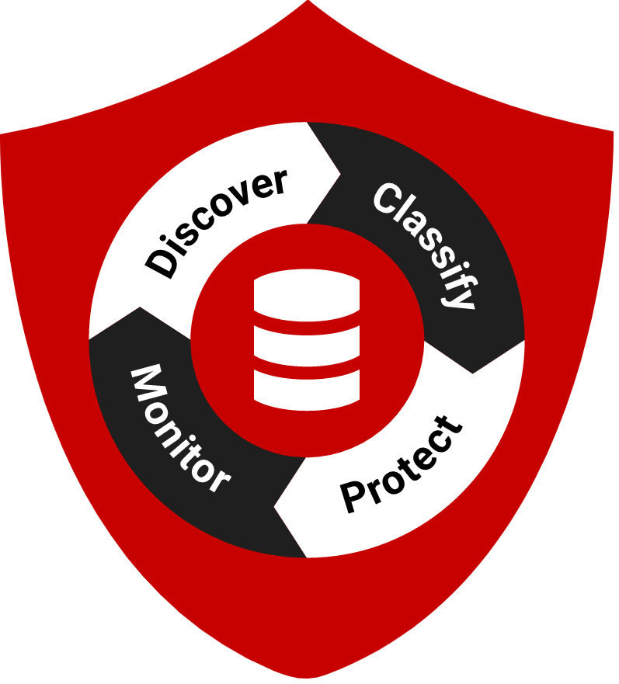
Data Compliance in Software Delivery
What do you process?
What needs protecting?
Who has access and for what purpose?
How can you demonstrate adequate protection?
Move from tell me to show me…
…consistent processes are key
Notes:
What data do you process – what do you collect, use, store, remove - visibility of what you have provisioned even if its not be used / accessed is still important for compliance – otherwise you end up with sprawl
What data needs protection – make sure you know what you have an classify it – this is important so you know what you need to protect outside production in order to comply
Access and for what purpose – can go giving PII data to a bunch of devs – has consent been given for its use ie in development

Slide 10
Demo – Classifying sensitive data
Notes:
Show new Data Cataloguing functionality i.e. classification – can’t really show discovery right now as it’s done with the DBATools PowerShell cmdlets
Drill down into Forums-Redgate-Com Production as that’s what we’re going to be provisioning
Work through a couple of suggestions and apply them
Then show the Clone integration to prove it forms the center of truth for our masking/provisioning strategy

Slide 11
“67% of organizations use a copy of the production database in development and testing."
2018 State of Database DevOps Survey

Slide 12
Conflicts to solve
Teams want to move fast
DBAs must protect data
up-to-date, realistic data
on-demand access to consistent database copies
all copies of data accounted for
sensitive data must be sanitized

Slide 13
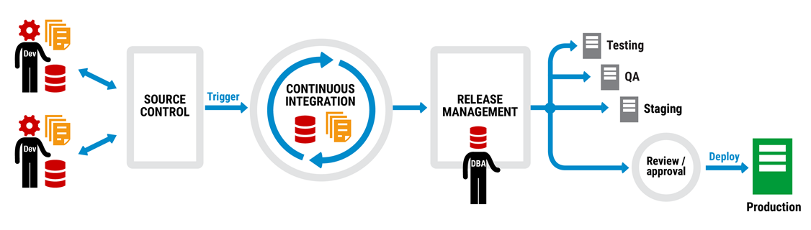
DevOps as we know it is changing
Notes:
Until now the delivery pipeline for database changes has been somewhat straightforward. We focus on taking changes made, tracking them and understanding the impact and moving them up through a process of either manual deployments or indeally an automated Continuous Integration and Deployment process. But this does assume that the only thing we are concerned with is delivering value and protection in 1 direction, whereas the reality is that data is moving in all directions.
The key then is to not consider Production as the "end goal" or finish line in Database development, as value and protection do not end here along with desired changes.
Rather the key is to think more of Production as the sun at the centre of our universe, the key asset that forms part of a cyclical process and gives light to all of the inner workings of our Database development.

Slide 14
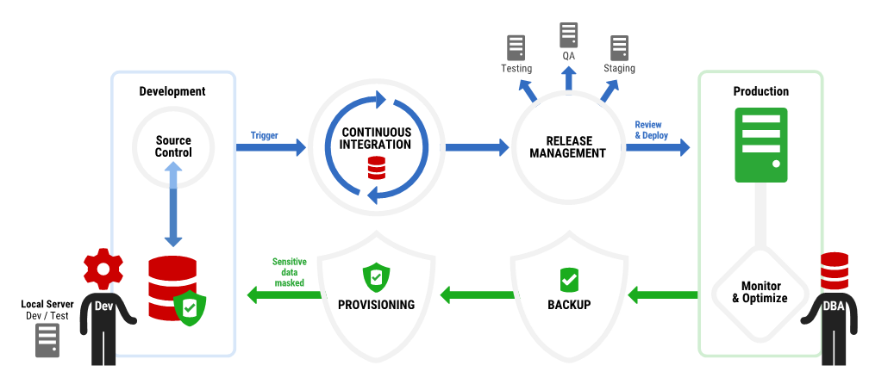
DevOps as we know it is changing
Notes:
When we put in place a loop now, we understand that data travels backwards as well as forwards. We cannot deliver value to our customers and end-users without first understanding the impact of these changes on real data.
Ultimately both sides of the coin delivers value to the other in a very yin-yang, symbiotic relationship.
Now the very concept of DevOps as far as the database is concerned is broadened to encompass other (historically risky) processes, as by controlling, automating and protection our workflow in both directions we enable compliance as well as deployment and reduce our attack surface.

Slide 15
Demo – Provisioning Data
Notes:
Show forums-redgate-com-dev <- bad because it’s a backup and restore, PII etc.
Show masking set for Forums-Redgate-Com
Brief explanation of what its doing – sub & sync
Show Clone dash, explain how Clone works – images & Clones
Show where masking set gets applied
Run PowerShell and show automation, create multiple environments

Slide 16
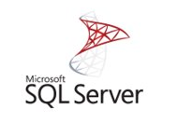
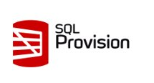
How does provisioning reduce your attack surface area?
1TB
PRODUCTION
1TB
PRODUCTION
IMAGE
1TB
1TB
STAGING
48MB
STAGING
48MB
TEST
1TB
TEST
48MB
QA
DEVELOPMENT
48MB
DEV_1
1TB
48MB
DEV_2
4 environments = 4TB
6 environments = ~2.001TB
PII is duplicated
PII ONLY in PROD
Notes:
When there are fewer assets for us to worry about, even if there are vulnerabilties that can be exploited to gain access to the data in pre-production - because we have anonymised it, there exists a much smaller risk to our customers.
This is alongside the added benefits to us as a company that we can quickly spin up low footprint, easy to use Clones whether this is for dedicated, sandboxed development or more agile testing. SQL Provision enables Compliant Devops at each stage of the pipeline and lets us move value up to Production quickly.
In summary [next slide]

Slide 17
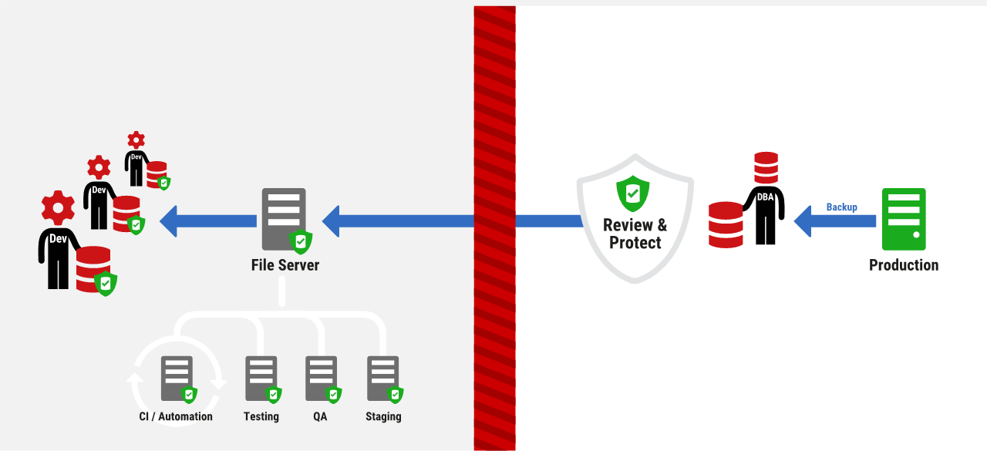
Stay Compliant AND use Production like Data
Notes:
SQL Provision introduces the equivalent of a Data Firewall. We provide a way of getting production-like data to developers and testers, people who catagorically don't need access to Production data, and of course mitigate all of the factors that meant in the past we weren't able to do this.
This enables us to ensure that anything we do in pre-production is heavily tested to make sure it will work when promoted, but ensures we are doing the very thing we should be doing from the start, protecting our customers information.

Slide 18
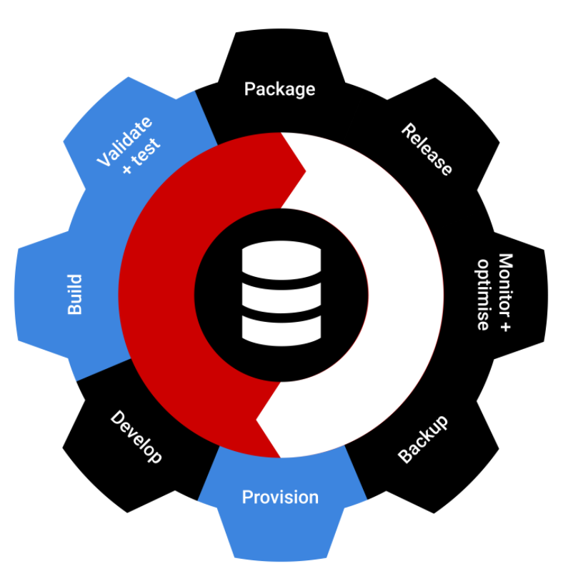
Achieving Database DevOps Success
Continuous Integration & Deployment
Environments & Deployment
Protecting & Preserving Data
Notes:
Steve

Slide 19
Thank you
sqlprovision@red-gate.com
red-gate.com/hub
sjones@sqlservercentral.com
@way0utwest
chris.unwin@red-gate.com
@RedG_Chris

